Slide 1
HILL CIPHER
LINEAR ALGEBRA

Slide 2
GROUP MEMBERS : -
ADITYA KUSHWHA
NEEL KASHYAP
RITHWIK MANDA
SATYAM SINHA

Slide 3
Hill Ciphers
Lester Hill, 1929. Not used much, but is historically significant: first time linear algebra used in crypto
Use an n x n matrix M. Encrypt by breaking plaintext into blocks of length n (padding with x’s if needed) and multiplying each by M (mod 26).
Example: Encrypt “hereissomeonetoencrypt” using M
her eis som eon eto enc ryp txx
(7, 4, 17) (4, 8, 18) … (19, 23, 23)
(2, 5, 25) (0, 2, 22) … (0, 22, 15)
cfz acw yga vns ave anc sdd awp
“CFZACWYGAVNSAVEANCSDDAWP”

Slide 4
Decrypting
Reverse the process, multiplying each block by M inverse (mod n)
Theorem: If a matrix M is invertible mod n, then gcd(det(M), n) = 1

Slide 5
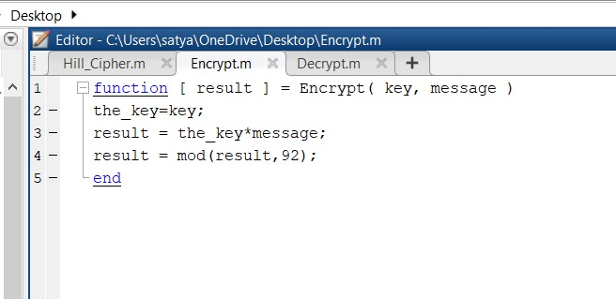

Slide 6
Modular matrix inverse
The Hill cipher requires us to invert a matrix mod 26.
For a 2x2 matrix, this is easy.
Many numerical packages allow us to invert a matrix, but using floating point numbers.

Slide 7
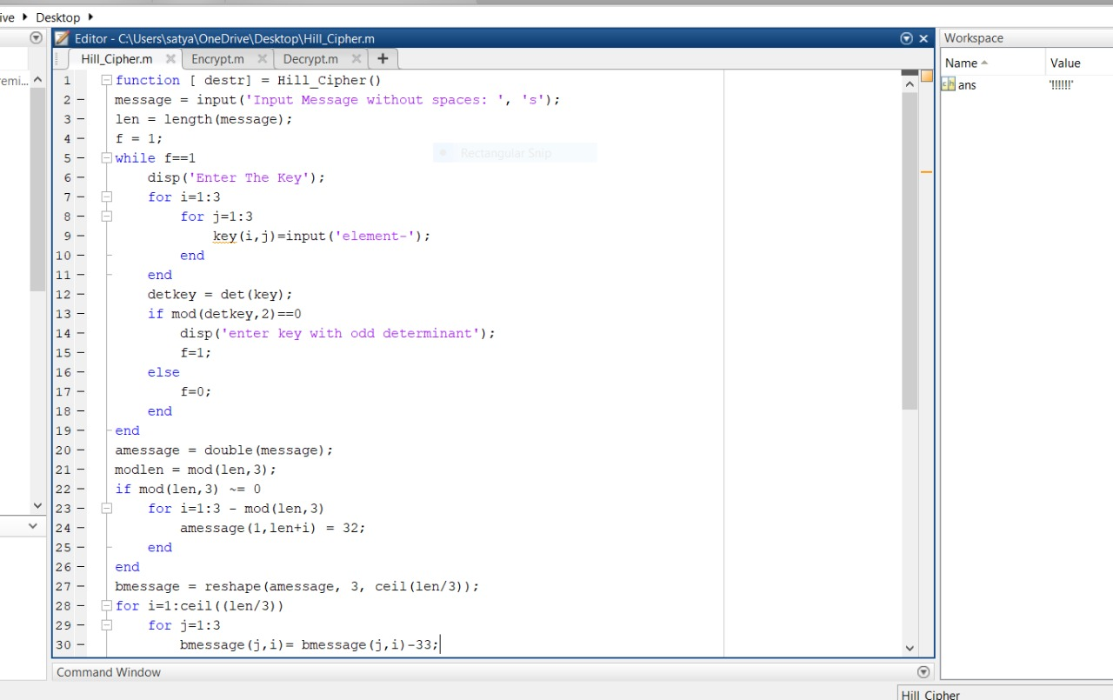

Slide 8
Thank you

